Slide 1



CitiusTech Authors:
Kagori, Michael -Data Architect / Data Modeler
Velaga, Sudhir - Healthcare Solution Architect
PHS Authors:
Venkat Chebrolu – IRADW Solution Lead
IRADW - Special Data Sharing Meeting
(Integrated Reporting & Analytical Data Warehouse)
Sept 24th 2018
This document is confidential and contains proprietary information, including trade secrets of CitiusTech. Neither the document nor any of the information contained in it may be reproduced or disclosed to any unauthorized person under any circumstances without the express written permission of CitiusTech.

Slide 2
Agenda
IRADW Project Objective
CitiusTech experience in IBM UDMH space
IRADW Architecture Objectives
IRADW Multi-Tenant Stakeholder Requirements
  IRADW Multi-Tenant Solution Highlights
  IRADW Multi-Tenant Data Model
    Organization Logical Data Model
    Tenant Logical Data Model
    Organization & Tenant Logical Data Model
    Tenant & Source System Logical Data Model
    Example of Plan Member
    Example of Patient
IRADW Data Security Stakeholder Requirements
  Data Classification & Segmentation / Data Sharing Across Business Units
  IRADW Data Security Design Solution Highlights
    IRADW Provisioning Data Model
Appendix

Slide 3
IRADW Project Objective
(Integrated Reporting & Analytical Data Warehouse)
Objective: One of the PHS vision would be global information flow and the development of an integrated data warehouse system, using Clinical data on all patient encounters and Health Plan data on all operating transactions for members as part of an integrated health care system. This new integrated data warehouse system will be used for multiple purposes, including patient care, health services research, resource utilization , feasibility studies and much more. This approach to building a centralized data system comprised of multiple repositories efficiently meets a variety of individual and aggregate information needs, while reducing the need to create duplicate databases.

Slide 4
CitiusTech IBM UDMH Expertise
PHS IBM UDMH Integration Partner
CitiusTech is a specialist provider of healthcare technology services and solutions, with strong presence across the globe. CitiusTech has implemented different use cases for Multi-Tenancy & Data Security for different health care clients. The solutions are based on IBM UDMH 9.X Multi Tenancy & Data Provisioning Subject areas. The use cases involves integrating multiple data sources across multiple tenants.
Following are sample Use Cases that were successfully implemented to support enterprise tenant compliance reporting with clinical & financial data based on IBM UDMH 9.x
  HIPAA compliance
  Financial compliance requirement
  Compliance reporting based on UDMH 9.x
  Data Sharing Agreements across tenants
  Client has multiple tenants and multiple source systems per tenant
  Capitated population requirement
  Role based security

Slide 5
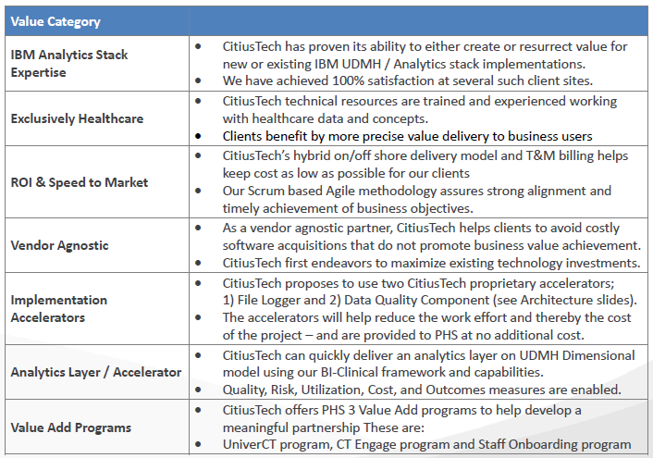
CitiusTech IBM UDMH Expertise Cont’d..
PHS IBM UDMH Integration Partner

Slide 6


CitiusTech IBM UDMH Expertise Cont’d..
PHS IBM UDMH Integration Partner
Source Systems
1
IRADW on IBM PDA
EPIC
*Data Quality Component
Tenant Security Views
6
11
DQ Rules
DQ Log
9b
Facets
RDM
MDM
2
9a
MDM/ RDM
Staging Area
E.g. Epic
E.g. Epic (Master/Rltn/Array)
Anchor
(E.g. claims)
Dimension
(E.g. clm dim)
E.g. Epic
Databases
Facets
Facets
MDM/ RDM
MDM/ RDM
Detail
(E.g. claim detail)
Fact
(E.g. clm fact)
OptumRX Cognos
E.g. Facets (Master/Rltn/Array)
3
*File Reader
Link (E.g. claim/claim line)
Bridge (E.g. clm 2 pract brg)
OptumRX SharePoint
File Reader
E.g. OptumRX
E.g. OptumRX
E.g. OptumRx (Master/Rltn/Array)
Array
(E.g. claim line amount)
Array
(E.g. clm cdtn cd otr)
Files
File Validator
PL
CL
AWM
DWM
4
5
7
8
ETL
Job control
Audit
Logging
Notification
ELT
Operations Metadata and Auditing
* CT Accelerators
10

Slide 7
IRADW Multi-Tenant Architecture and Security Design Document Review Meetings Conducted so far
Project sponsor review
Enterprise Architect / IT Security (CTO & CSO representation)
Project sponsor review along with IT EDW Director
PHS Legal Counsel / Privacy Office – Sept 24th 2018

Slide 8
IRADW Architecture Objectives
  Leverage existing IT EDW implemented IBM IIS, database platform, Infrastructure and investments made to date to support PHS business growth model including Fluent Health
  Enable organizational readiness for PHS to manage the IBM solution moving forward in line with business growth strategy
  Enable the IBM Unified Data Model for Healthcare which supports Multi Tenant data model architecture that is scalable beyond PHS New Mexico members & patients population (ex: extend solution to NCPOP)
  Enable the IBM Unified Data Model for Healthcare to successfully integrate and manage Clinical & Claims data (Health Plan & Delivery Systems)
  Design and Implement Security measures at various stages of Enterprise Data Warehouse Life cycle including Data Sharing policies Reference Number DAN.PHS-E.002 – See Appendix Data Sharing Across the Business Units / Capitated Providers
  Design and develop IBM Unified Data Model for Healthcare solution as subject oriented, integrated, time variant and nonvolatile manner to facilitate analytical support.
  IBM assessment (on existing approved data infrastructure) key findings were taken into consideration – See Appendix IBM assessment findings

Slide 9
IRADW Stakeholder Multi-Tenant Requirement(s)
  Apply consistent methodology and guidelines for all Tenants that are defined by PHS Enterprise. The IBM Unified Data Model for Healthcare deployment must be scalable in order to handle future growth.
  Multiple tenants must co-exist in a single IBM UDMH / PDA infrastructure and must ensure that each tenant can access only the data that they are authorized to use
    Must develop Tenant onboarding process in IRADW Enterprise Data Warehouse.
    Must ensure that each Tenant can access only the data that they are authorized to use.
    Must have unique identifier for each Tenant. This approach must be enterprise standard. See Appendix Organization(s) / Tenant(s) Setup Process in IRADW
    After multi-tenancy is enabled, The IT Operations must record user activities using audit logging capabilities.
    Tenant metadata must be managed using the standard administration capabilities.
    The containment rules for multitenancy must maintain security and ensure isolation between tenants. Must also ensure that the rules dictate how the content is created and where it can be located.

Slide 10
Solution Highlights: Multi-Tenancy Data Model Design
Multi-tenant capable data environment consist of multiple customers or organizations, called Tenants.
IBM UDMH: IBM provides a multi-tenant capable data reservoir with a Unified Data Model for Healthcare (UDMH), which defines a logical model to represent essential entities and relationships of the healthcare industry to help normalize data across data sets for use in Analytics. Multitenancy is the capability of an application to support multiple tenants from a single deployment. It ensures that within each tenant, users can access only the data that they are authorized to use.
Organizational Hierarchy: An association between two organizations based on management, ownership or reporting hierarchical structure. Defining the organizational hierarchy is important in designing the data access security requirements
Tenant: The legal owner of data. A tenant controls what data any user can access. In this multi-tenant architecture, the tenant number associates every record with the appropriate tenant.
Source System: The details of the source system or vendor where the data is sourcing into UDMH
IBM RDM: Consistent approach to maintain, collect and load the organizational and tenant master data that provides the governance, process, security, and audit control for managing reference data as an enterprise standard, resulting in fewer errors, reduced business risk, and cost savings See Appendix Organization(s) / Tenant(s) Setup Process in IRADW

Slide 11
Organizational Hierarchy
The first building block in Multi-Tenant Data Model Design
* Organization / Company / Tenant must have valid federal tax identifier

Slide 12
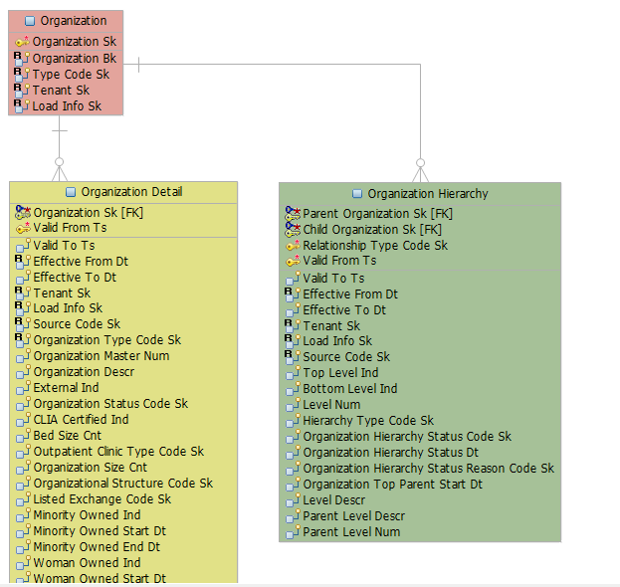

IBM UDMH - Organization Logical Data Model
A logical data model or logical schema is a data model of a specific problem domain expressed independently of a particular database management product but in terms of data structures such as relational tables and columns.
Note: Organizational Hierarchy information will feed into this data model
Anchor: Anchor contain a list of unique business keys with low propensity to change.
Detail: Detail contain attributes about the Anchor
Associative: Store relationships between anchors

Slide 13
Organization Logical Data Model Cont’d..
Organization Table
  PHS to confirm to Type Codes
Organization Hierarchy
Org SK | Org Bk | Type Code
80 | PHS | Parent Health Care Company
81 | PHS_H | Health Care Company
82 | PHS_D | Tenant
83 | FLUENT | Health Care Company
84 | PNI | Tenant
87 | NCPOP | Tenant
88 | PLPCC | Tenant
Note: Organizational hierarchy is valuable information to report on the type of relationship between these organizations
Parent Org BK | Child Org BK | Relationship Type | Valid from | Valid To | Level Desc
PHS | PHS_H | Parent Health Care Company 2 Health Care Company | 8/1/2018
PHS_H | PHS_D | Health Care Company 2 Tenant | 8/1/2018
PHS | FLUENT | Parent Health Care Company 2 Health Care company | 8/1/2018
FLUENT | PNI | Health Care company 2 Tenant | 8/1/2018
FLUENT | NCPOP | Health Care company 2 Tenant | 8/1/2018
FLUENT | PLPCC | Health Care company 2 Tenant | 8/1/2018
  *PHS to provide Business Keys. The business keys represented here only for conceptual

Slide 14
Organization Logical Data Model Cont’d..
Note: Example of output report from Organization data model
Org Hierarchy basic report example
  List of Tenants
  PHS
  PHS_D (Presbyterian Delivery System)
  PNI (Presbyterian Network Inc.)
  NCPOP (North Carolina Provider Owned Plans)
  PLPCC (Provider Led, Patient Centered Care)
Org Type | Branch 1 | Branch 2 | Branch 3 | Branch 4 | Branch 5
Parent Health Care Company | PHS | PHS | PHS | PHS | PHS
Health Care Company | PHS | PHS_H | FLUENT | FLUENT | FLUENT
Tenant | PHS | PHS_D | PNI | NCPOP | PLPCC

Slide 15
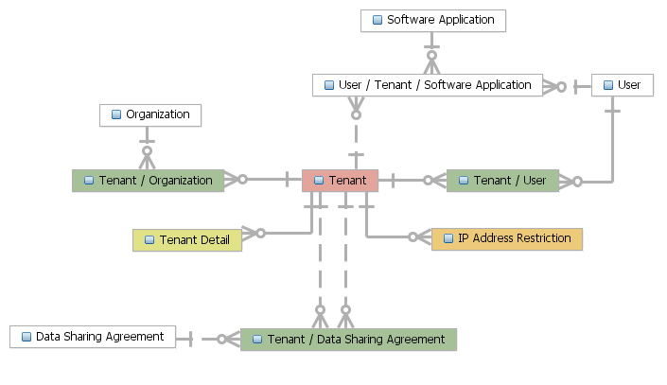
IBM UDMH - Tenant Entity-relationship Model
The second building block in Multi-Tenant Data Model Design. An entity–relationship model describes interrelated things of interest in a specific domain of knowledge. A basic ER model is composed of entity types and specifies relationships that can exist between instances of those entity types
Data Security topic

Slide 16
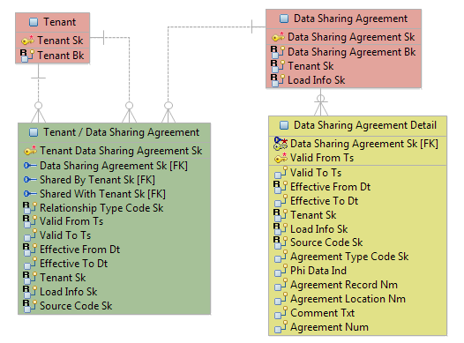
IBM UDMH - Tenant Logical Data Model
A logical data model or logical schema is a data model of a specific problem domain expressed independently
of a particular database management product but in terms of data structures such as relational tables and columns.
Note: Tenant information will feed into this data model
Anchor: Anchor contain a list of unique business keys with low propensity to change.
Detail: Detail contain attributes about the Anchor
Associative: Store relationships between anchors

Slide 17
IBM UDMH - Tenant Logical Data Model Cont’d…
Tenant Sk | Tenant BK *
1001 | PHS_D
1002 | PNI
1003 | NCPOP
1004 | PLPCC
1005 | PHS
Note: Designation of Tenant is valuable information to secure the data. Tenant is data custodian.
Note: PHS, in addition to being an Organization, is also a Tenant for IRADW Integration. In IRADW, we have data standardization at the enterprise level and so PHS will act as the Tenant of such data sets
Tenant Table
Detail Table
Tenant Sk | Valid From | Valid To | Tenant Name | Display Name *
1001 | 8/1/2018 |  | Presbyterian Delivery Services | PHS_D
1002 | 8/1/2018 |  | Presbyterian Network Inc. | PNI
1003 | 8/1/2018 |  | North Carolina Provider Owned Plans | NCPOP
1004 | 8/1/2018 |  | Provider Led Plan Patient Care | PLPCC
1005 | 8/1/2018 |  | Presbyterian Healthcare Services | PHS
  *PHS to provide Tenant Business Keys

Slide 18
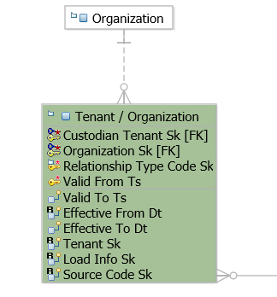
IBM UDMH – Organization & Tenant Logical Data Model
Note: Organization and Tenant relationship information will feed into this data model
Anchor: Anchor contain a list of unique business keys with low propensity to change.
Detail: Detail contain attributes about the Anchor
Associative: Store relationships between anchors

Slide 19
IBM UDMH – Organization & Tenant Logical Data Model
(Organization & Tenant relationship example with data)
Custodian Tenant BK | Organization BK | Relationship Type | Valid from | Valid To | Source Cd
PNI | FLUENT | Tenant 2 Health Care Company | 8/1/2018 |  | RDM
NCPOP | FLUENT | Tenant 2 Health Care Company | 8/1/2018 |  | RDM
PLPCC | FLUENT | Tenant 2 Health Care Company | 8/1/2018 |  | RDM
PHS_D | PHS_H | Tenant 2 Health Care Company | 8/1/2018 |  | RDM
PHS | PHS | Tenant 2 Health Care Company | 8/1/2018 |  | RDM

Slide 20
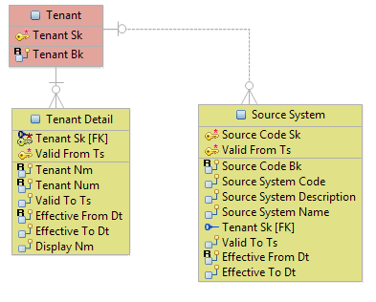
IBM UDMH – Tenant & Source System Logical Data Model
Note: Tenant and Source System relationship information will feed into this data model
Anchor: Anchor contain a list of unique business keys with low propensity to change.
Detail: Detail contain attributes about the Anchor
Associative: Store relationships between anchors

Slide 21
IBM UDMH - Tenant & Source System Logical Data Model Cont’d.. (Source System entity example with data)
Source Code SK | Valid From | Source Code BK | Source Sys Desc | Source Sys Name | Tenant
81 | 8/1/2018 | PHS_D~EPIC | Presbyterian Delivery System Epic Clarity | Epic Clarity | PHS_D
82 | 8/1/2018 | PNI~FCTS | PNI Facets ODS | Facets ODS | PNI
83 | 8/1/2018 | NCPOP~FCTS | NCPOP Facets ODS | Facets ODS | NCPOP
84 | 8/1/2018 | PHS~ENTP | PHS Enterprise | PHS Enterprise | PHS
IRADW Solution Architecture Team in coordination with Data Governance will define the source System business keys, Source system Name & Source Sys Description for IRADW IBM UDMH data model
Note: Designation of Source system with Tenant is valuable information to identify where the data is originated from

Slide 22
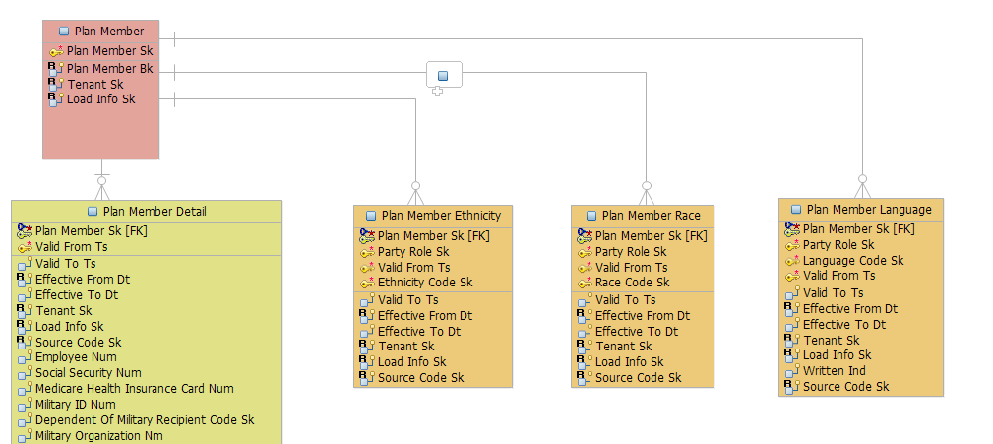
IBM UDMH: Tenant Entity-relationship with Health Plan Data
This is only an example to show how Tenant is related to every source data that will be ingested into IBM UDMH data model

Slide 23
IBM UDMH: Tenant Entity-relationship with Health Plan Data
Cont’d..(Example with data)
Plan Member Table (Shows the data row belongs to which Tenant)
Plan Member Detailed Table (Shows the data row belongs to which Tenant and source system)
Plan Member Sk | Plan Member Bk | Tenant (Conceptual)
11 | PNI~FCTS~894844 | PNI
12 | NCPOP~FCTS~7478379 | NCPOP
Note: Health plan data Tenant and source system will be captured at every data row level
Plan Member Sk | Valid From | Valid To | Effective From Dt | Effective To Dt | Tenant | Insurance Num | Source Code
11 | 8/1/2018 |  | 5/20/2017 |  | PNI | 894844 | PNI~FCTS
12 | 8/1/2018 |  | 8/7/2015 |  | NCPOP | 7478379 | NCPOP~FCTS
The Plan Member business key is used here only for conceptual we will using actual business key value from data

Slide 24
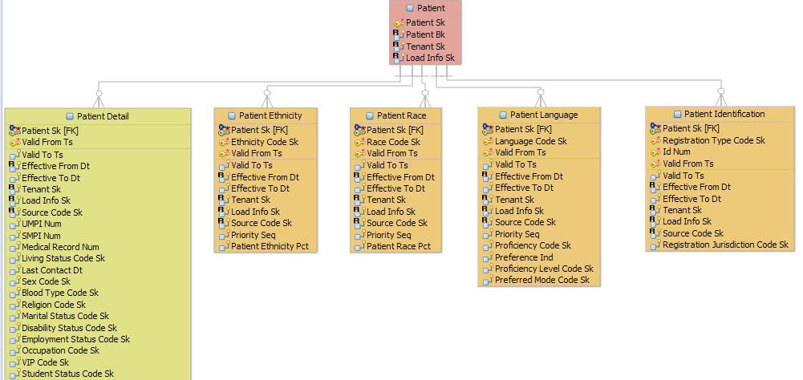
IBM UDMH: Tenant Entity-relationship with
Delivery System Data
This is only an example to show how Tenant is related to every source data that will be ingested into IBM UDMH data model

Slide 25
IBM UDMH: Tenant Entity-relationship
with Delivery System Data Cont’d.. (example with data)
Patient Table (Shows the data row belongs to which Tenant)
Patient Detail Table (Shows the data row belongs to which Tenant and source system)
Patient Sk | Patient Bk | Tenant
1 | PHS_D~EPIC~894844 | PHS_D
Note: Delivery system data - Tenant and source system will be captured at every data row level
Patient Sk | Valid From | Valid To | Effective From Dt | Effective To Dt | MRN Num | Gender | Tenant | Source Code
1 | 8/1/2018 |  | 5/20/2017 |  | 894844 | Female | PHS_D | PHS_D~EPIC

Slide 26
IRADW Data Security
Comply with PHS standards
Data Classification & Segmentation
Information Protection Standards
Data Sharing Across business units / Capitated Provider
Enterprise Architecture
Information Security
Legal & Compliance

Slide 27
Data Classification and Segmentation
(Based on IRADW Releases 1,2 & 3)
Data | Type | Participating Component | Data Classification | Data Segmentation | Data State | Encrypted
Health Plan Membership, Claims, Product, Provider, Lab results, Member Satisfaction | PHI / PII | Database | Internal / Confidential / Restricted | Data Packet/Encapsulated | At rest (No Access) | At Rest: No Access will be provided while data is at rest At Motion: Role based security to comply with HIPAA-compliant , Anti-Trust laws , Data sharing across business units and capitated providers
 |  |  |  |  | At Motion (Role based Access)
Delivery System Patient Lab results, Encounters, Medication, Patient Satisfaction |  |  |  |  | At rest (No Access)
 |  |  |  |  | At Motion (Role based Access)
See role based security design for data protection at motion

Slide 28
Data Security Stakeholder Requirements
Must secure Protected Health Information (PHI) or Personal Identifiable Information (PII) in a method that will comply with HIPAA-compliant data environment. In Scope for IRADW
Must comply with Anti-Trust laws in a method that will provide confidence in information sharing between healthcare entities. In Scope for IRADW
Must provide an adequate amount of authentication in order to meet the business requirements for security. In Scope for IRADW
Must provide data provisioning limitation based on the tenant's role and the data sensitivity. In Scope for IRADW
Must protect the data in motion using appropriate algorithm as per information security guidance and policies. In Scope for IRADW
Must implement strong, granular and auditable security controls. Out of Scope for CitiusTech but In Scope for day to day operations
Implement Netezza LDAP authentication
Apply OHCA Type & Healthcare Operations Restrictions as applicable Reference Number DAN.PHS-E.002 – See (Appendix Data Sharing Across the Business Units / Capitated Providers) In Scope for IRADW

Slide 29
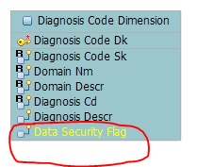
Solution Highlights: Data Security Design
IBM UDMH package provides tables that contains data elements that support information related to control of user access to application functionality.
IBM UDMH package provides tables that contains data elements that support grouping of users that is based on business role
IBM UDMH package provides tables that contains data elements that support Object Permissions based on business role
Enterprise sensitivity codes in code domain module entity will be customized by adding additional data elements to flag them. The flagged sensitivity codes will be excluded in data provisioning as per guidelines

Slide 30
Solution Highlights: Data Security Design Cont’d..
IBM RDM: Integration with IBM Reference Data Management will be developed to securely access the restricted Mental health codes, HIV & STD Codes, OB Codes etc.. that provides the governance, process, security, and audit control for managing reference data as an enterprise standard, resulting in fewer errors, reduced business risk, and cost savings. See Appendix Overall IRADW Security Context
LDAP (Light Directory Access Protocol) Authentication: IRADW team successfully enabled Netezza LDAP authentication in Development environment. Netezza appliance can use PHS external authentication server which is used for most other application authentication log-in security, hence there is only one placed to maintain authentication information and therefore LDAP authentication provides ease of management for access provisioning. See LDAP Configuration
  For example, when a user logs into a computer that is part of a Windows domain, Active Directory checks the submitted password and determines whether the user is a system administrator or normal user.

Slide 31
Solution Highlights: Data Security Design Cont’d..
IBM UDMH security design includes minimum three tenant security Roles for all Health Plan tenants to protect PHI / PII data access in IRADW
  R1/Regular – NOPHI - Protected Health Information (PHI) (ex: such as member id and name) will be masked and excluding sensitivity codes
  S2/Secure –NOHAPHI - House Account (Employee) PHI will be masked, all other PHI will be available and excluding sensitivity codes
  P3/Private – ALLPHI - All PHI data is available including House Account (Employee) and including sensitivity codes?
IBM UDMH security design includes minimum two tenant security Roles for all Health Delivery System tenants to protect PHI / PII data access in IRADW
  R1/Regular – NOPHI - Protected Health Information (PHI) (ex: such as member id and name) will be masked and excluding sensitivity codes
  S2/Secure –NOHAPHI? (This is not required as R1/ Regular will mask all PHI information)
  P3/Private – ALLPHI - All PHI data is available and including sensitivity codes?
* IRADW solution team will work with Data Sharing committee while building the objects to share with different Roles

Slide 32
Solution Highlights: Data Security Design Cont’d..
IBM UDMH security design includes one more additional tenant security Role(s) for Data Sharing between organizations / tenants in the context of Capitation arrangement ONLY
  R1 Health Plan Data Sharing/Regular – NOPHI - Protected Health Information (PHI) (ex: such as member id and name) will be encrypted or masked , excluding sensitivity codes and Health Plan can share Provider information, header level claim data such as dummy financial data based on a determined % of actual allowed and also can share the following clinical data with capitated arrangement provider tenant users - CPT/HCPC/Revenue/ICD9-10 Procedure codes , Diagnosis/MS-DRG codes, Prescriptions, Responses to Health Risk Assessments , Problem Lists , Care Plans , Orders and Referrals , Prior Authorizations , Level of Income Support , Lab Results , Biometric screenings , Vital signs , Risk Scores , Patient Pain Scores , Activity of Daily Living Results with capitated arrangement provider tenant users
  R1 Delivery System Data Sharing/Regular – NOPHI - Protected Health Information (PHI) (ex: such as member id and name) will be encrypted or masked , excluding sensitivity codes and delivery system can share Charge to Payer (No Cost Data will be Shared) and Payer Type and also can share the following clinical data with capitated arrangement provider tenant users - CPT/HCPC/Revenue/ICD9-10 Procedure codes , Diagnosis/MS-DRG codes, Prescriptions, Responses to Health Risk Assessments , Problem Lists , Care Plans , Orders and Referrals , Prior Authorizations , Level of Income Support , Lab Results , Biometric screenings , Vital signs , Risk Scores , Patient Pain Scores , Activity of Daily Living Results allowed with capitated arrangement health plan tenant users
* IRADW solution team will work with Data Sharing committee while building the objects to share with Data Sharing Role

Slide 33
Solution Highlights: Data Security Design Cont’d..
Sensitive & Restrictive Codes
Diagnosis SK | Diagnosis Cd | Diagnosis Description | Data Security Flag
1 | A37.90 | Whooping cough, without pneumonia. | 0
2 | B20 | Human immunodeficiency virus [HIV] disease | 1
3 | A54.81 | A54.81~Gonococcal meningitis | 1
Data At Rest : No Access
Encounter ID | PAT ID | Prim Diagnosis Cd | Pat First Name | Sec Diagnosis | Tertiary Diagnosis Cd
1001 | P843899 | A37.90 ~ Whooping cough, without pneumonia | xxxxxx | B20 ~Human immunodeficiency virus [HIV] disease | A54.81~Gonococcal meningitis

Slide 34
Solution Highlights: Data Security Design Cont’d..
Examples
Data At Motion : Role Based Access R1 – Regular No PHI & No Access to Employee data
Encounter ID | PAT ID | Prim Diagnosis Cd | Pat First Name | Sec Diagnosis | Tertiary Diagnosis Cd
1001 | P843899 | A37.90 ~ Whooping cough, without pneumonia | xxxxxx | XXXXXXX | XXXXXXX
Data At Motion : Role Based Access S2 – Secure No PHI including Employee data
Encounter ID | PAT ID | Prim Diagnosis Cd | Pat First Name | Sec Diagnosis | Tertiary Diagnosis Cd
1001 | P843899 | A37.90 ~ Whooping cough, without pneumonia | xxxxxx | XXXXXXX | XXXXXXX
Data At Motion : Role Based Access P3 – Private PHI including ALL data with restricted codes?
Encounter ID | PAT ID | Prim Diagnosis Cd | Pat First Name | Sec Diagnosis | Tertiary Diagnosis Cd
1001 | P843899 | A37.90 ~ Whooping cough, without pneumonia | Smith xyz | B20 ~Human immunodeficiency virus [HIV] disease | A54.81~Gonococcal meningitis

Slide 35
Solution Highlights: Data Security Design Cont’d…
There are variety of options available how we can enable the security roles that we have reviewed in previous slides
Typically the security roles are defined in LDAP and the security roles are assigned to different Database schemas to hold the objects to share with R1, P2,S3 and R1 Roles (4 schemas per Tenant)=4 Tenants * 4=16 schemas. Maintenance nightmare
Provisioning - defining security roles in IBM UDMH application (4 schemas for all Tenants) - Preferred
    Easy to generate data access compliant reports
    Maintenance of Objects are much more organized
    Dynamic identification of users and their Tenant to tailor the data what user can see
    Supports Enterprise level view with ability for some enterprise business users to view all Tenant Data
    Supports enterprise reporting with no extra need to integrate the data

Slide 36
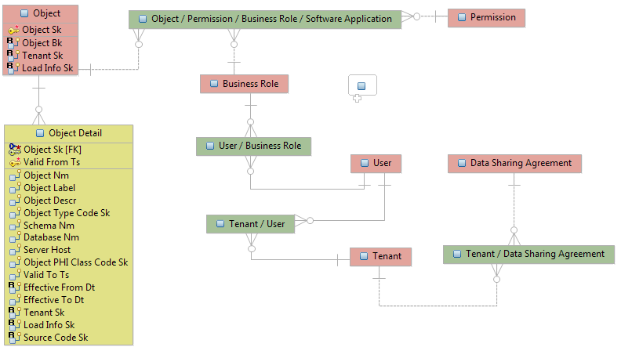
Solution Highlights: Data Security Design Cont’d…
Option 2 (IBM UDMH Data Model is flexible to support wide range of data security requirements)

Slide 37
Appendix

Slide 38
IBM Assessment key findings on existing
IBM EDW implementation
  Many PHS customized columns have no supporting column definition documentation.
  Many foreign key (FK) relationships are missing. Without accurate FK associations, table relationships are more difficult to discern.
  SRC_CD_SK was inconsistently added to a limited number of Atomic and Dimensional tables.
  Effective & Validity Dates appear to be used in a inconsistent manner and differs from intended design
  There are no logical/physical data models actively maintained and subsequently leveraged to perform customization tasks on the UDMH physical data model related database
  Table changes are made outside a data modeling tool.
  Only limited consideration was given to the usage of Tenant in the existing UDMH implementation.
  Tenant was mostly aligned to a source system and didn’t conceptually represent an entity with legal ownership and responsibility for the security of a tenant’s data.
√
√
√
√
√
√
√
√

Slide 39
IBM Assessment key findings on existing
IBM EDW implementation Cont’d..
No tenant related organizational hierarchies are represented in the existing UDMH implementation.
Row-based business keys don’t specify the full path to the source system table or file by tenant.
Data quality strategy and checks for of previously populated data model did not involve business subject matter experts to validate like for like data elements were populated in the model
There are currently no formally designated Data Stewards in the business working with the solution to ensure quality data is maintained within the eco system
Production data usage in EDW is not monitored.
There is a lack of knowledge and documentation of the location of sensitive data and its use and protection. Data owners have not been designated, classification has not been performed and security requirements for sensitive data implemented.
No tenant related organizational hierarchies are represented in the existing UDMH implementation.
Row-based business keys don’t specify the full path to the source system table or file by tenant.
Data quality strategy and checks for of previously populated data model did not involve business subject matter experts to validate like for like data elements were populated in the model
There are currently no formally designated Data Stewards in the business working with the solution to ensure quality data is maintained within the eco system
Production data usage in EDW is not monitored.
There is a lack of knowledge and documentation of the location of sensitive data and its use and protection. Data owners have not been designated, classification has not been performed and security requirements for sensitive data implemented.
√
√
√
√
√
√

Slide 40
Data Sharing Across the Business Units /
Capitated Provider
http://pel.phs.org/cs/groups/policyadministration/documents/policy/pel_00248119.pdf

Slide 41
Overall IRADW Security Context

Slide 42
Organization(s) / Tenant(s) Setup Process in IRADW
TSO is responsible to manage & implement Organization / Tenant Identifiers, Names etc. for Fluent in the source systems. Currently Bruce, Alexander is leading these efforts.
Data Analytics is responsible to manage & implement Organization / Tenant Identifiers, Names etc. for PHS and PLPCC for Delivery source systems. Currently Venkat Chebrolu with coordination of Data Governance will lead these efforts

Slide 43




CitiusTech
Practice Areas
Mobile Health Success Stories
Health Cloud Success Stories
Interoperability Success Stories
Thank You
CitiusTech Contacts
Abhay Singhal
Vice President, Provider Market
abhay.singhal@citiustech.com
972.533.5813
David Esser
Assistant Vice President , Provider Market
david.esser@citiustech.com
678.761.0717
www.citiustech.com

